Slide 1
W 207– Applied Machine Learning
Cornelia Ilin, PhD
School of Information
UC Berkeley
Introduction

Slide 2
About me
Faculty in the School of Information at UC Berkley
Research Scientist at Stanford University
Postdoc in the School of Information at UC Berkeley
PhD in Applied Economics (UW Madison)
Research at the intersection of health and environment

Slide 3
About you
Undergraduate major
Current job (if any)
Why Data Science at UC Berkeley?
Why W207?

Slide 4
Course websites
Lecture and Lab material will be uploaded on the course website: https://corneliailin.github.io/datasci_w207_summer2022/
Grades will be posted on ISVC: https://learn.datascience.berkeley.edu/

Slide 5
Live sessions organization
Each session is 90 minutes
30 minutes Q&A related to the topic of the week
30 minutes Code demonstration
30 minutes Breakout room exercises

Slide 6
Today’s learning objectives
General concepts of Machine Learning (ML)
Roadmap for building ML systems
Review of Numpy arrays

Slide 7
General concepts of ML
Q1: Can you make predictions about the future using ML? Provide an example.

Slide 8
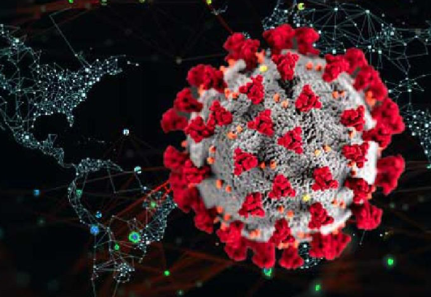
General concepts of ML
Q1: Can you make predictions about the future using ML? Provide an example.
Yes!
Example: predict number of COVID-19 cases and deaths

Slide 9
General concepts of ML
Q2: Name and explain the 3 types of ML supervision

Slide 10
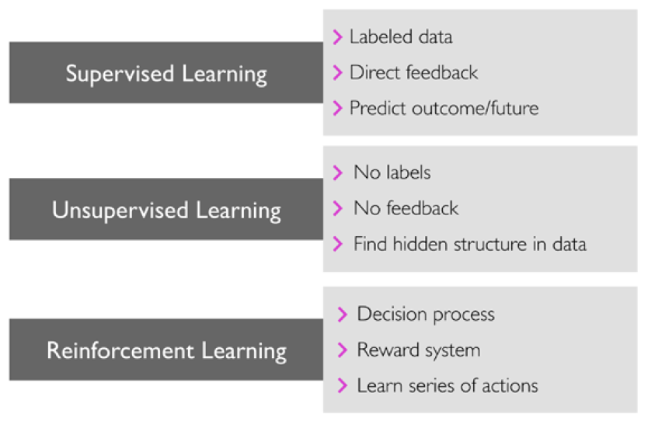
General concepts of ML
Q3: Name and explain the 3 types of ML supervision
Image source: S. Raschka and V. Mirjalili, Python Machine Learning

Slide 11
General concepts of ML
Q4: Name the 2 types of supervised ML models

Slide 12
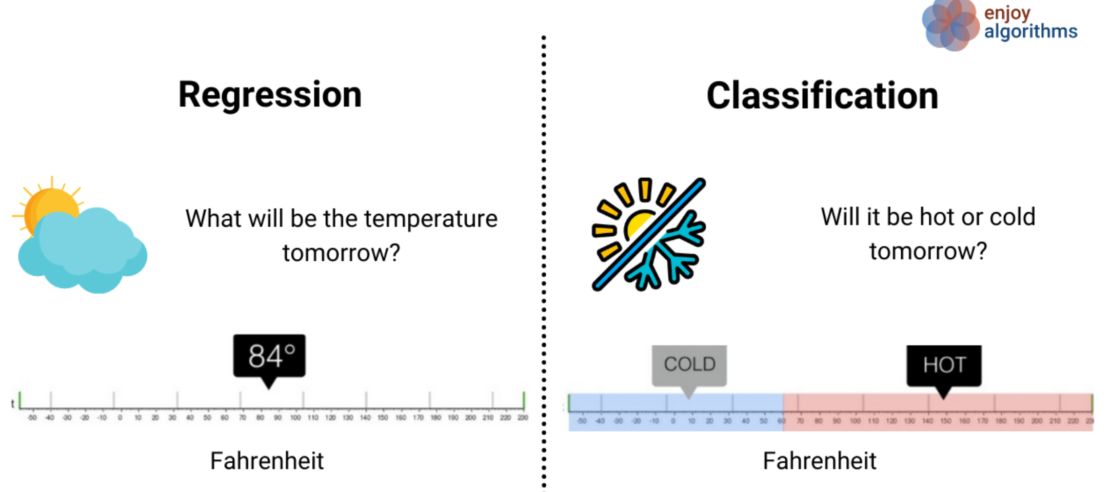
General concepts of ML
Q4: Name the 2 types of supervised ML models
Image source: https://www.enjoyalgorithms.com/

Slide 13
General concepts of ML
Q5: What is the goal of classification in ML? Provide an example.

Slide 14
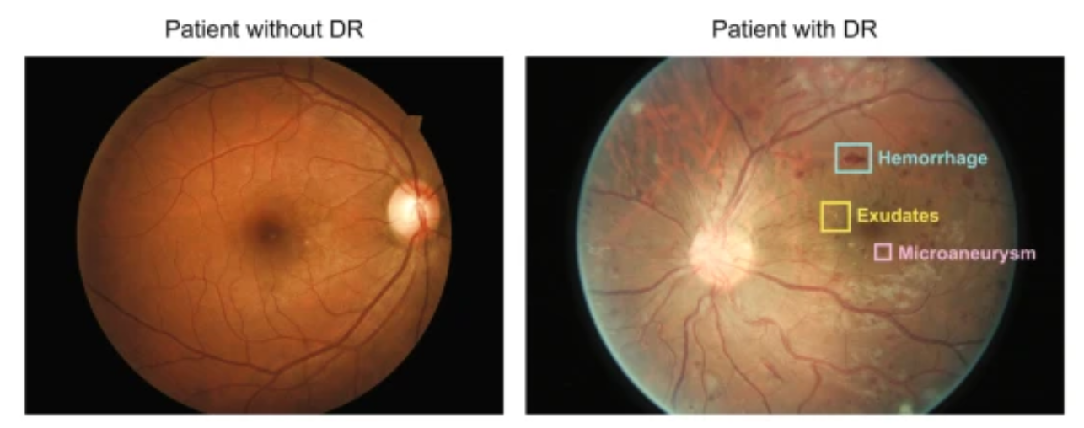
General concepts of ML
Q5: What is the goal of classification in ML? Provide an example.
Classification is a subcategory of supervised learning where the goal is to predict the categorical class labels of new instances, based on past observations.
Example: Diabetic retinopathy fundus image classification: refer a patient to a doctor or not.
Image source: https://www.nature.com/articles/s41746-019-0172-3

Slide 15
General concepts of ML
Q6: What is the goal of regression analysis in ML? Provide an example.

Slide 16
General concepts of ML
Q6: What is the goal of regression analysis in ML? Provide an example.
The task of classification is to assign categorical labels. Regression analysis is a subcategory of supervised learning and can be used to predict continuous outcomes.
Example: predict number of COVID-19 cases and deaths

Slide 17
General concepts of ML
Q7: True or False? Clustering is a technique used for structuring information and deriving meaningful relationships from data.

Slide 18
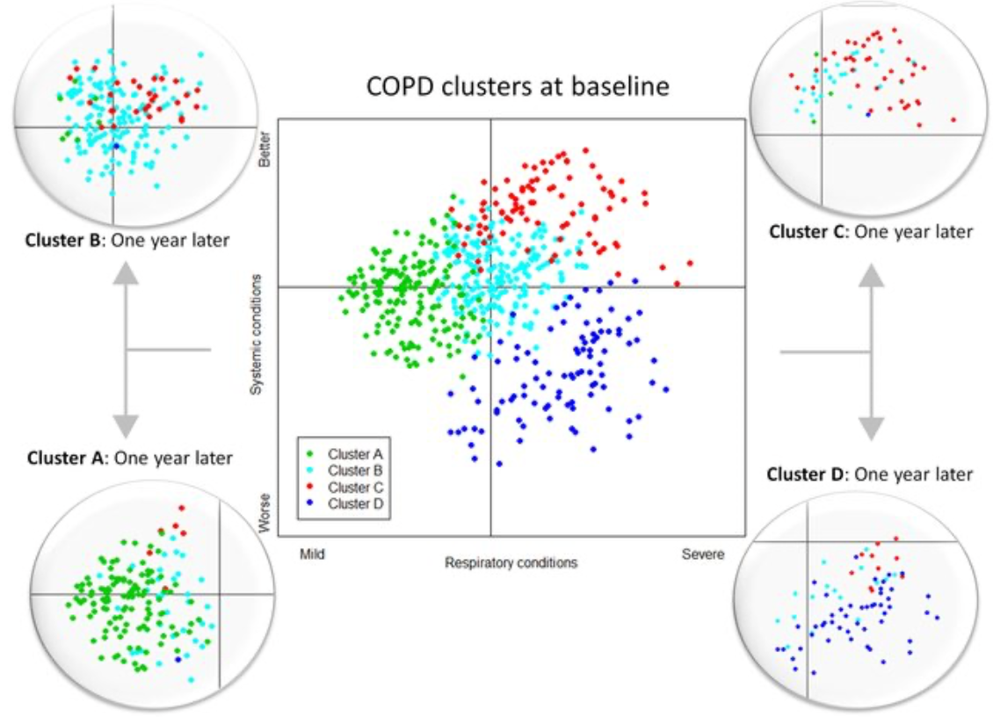
General concepts of ML
Q7: True or False? Clustering is a technique used for structuring information and deriving meaningful relationships from data.
True, it’s an unsupervised learning technique used to find subgroups in data.
Example: discover patient groups based on their diagnosis history in order to develop distinct treatment plans.
Image source: https://www.researchgate.net/publication/307969853_Chronic_Obstructive_Pulmonary_Disease_Subtypes_Transitions_over_Time/figures

Slide 19
General concepts of ML
Q8: What is Principal Component Analysis (PCA)?

Slide 20
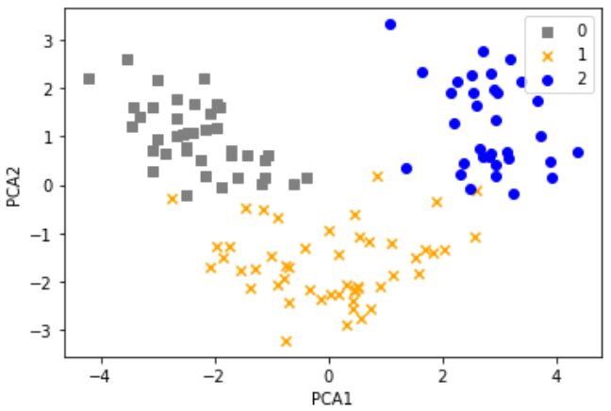
General concepts of ML
Q8: What is Principal Component Analysis (PCA)?
PCA is an unsupervised learning technique, useful when working with data of high dimensionality or for visualizing data.
Example: Common to combine PCA and clustering!

Slide 21
Roadmap for building ML systems
Q9: What is a typical workflow for using ML in predictive modeling?

Slide 22
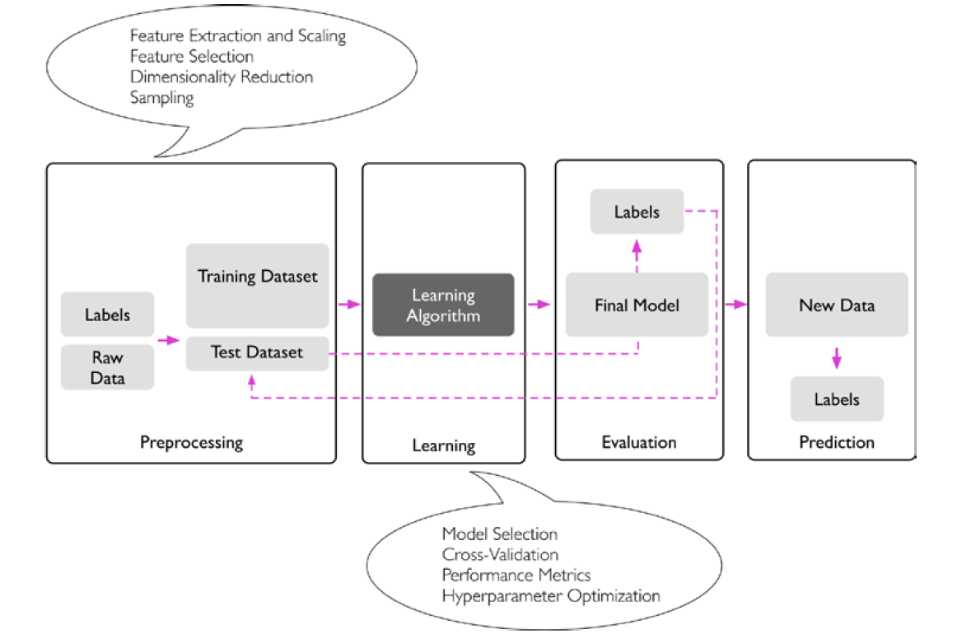
Roadmap for building ML systems
Q9: What is a typical workflow for using ML in predictive modeling?
Example: Introduction.ipynb (CI)
Image source: S. Raschka and V. Mirjalili, Python Machine Learning

Slide 23
Roadmap for building ML systems
Q10: Why do we need a train-test split? How do you evaluate prediction?
What is meant by generalization?
Image source: S. Raschka and V. Mirjalili, Python Machine Learning

Slide 24
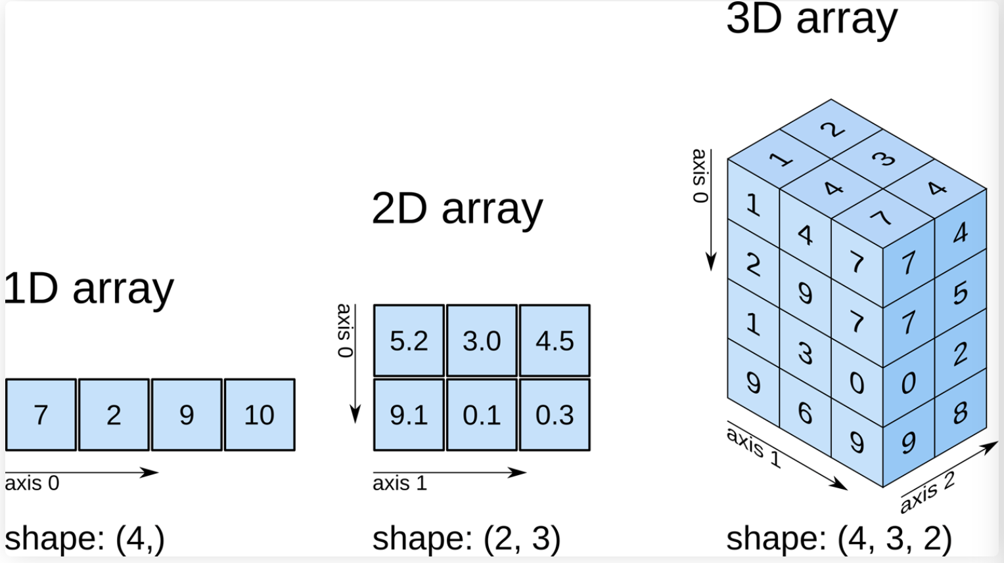
Review of Numpy arrays
API: https://numpy.org/doc/stable/reference/generated/numpy.array.html
Example: see Numpy_review.ipynb (students)

